Slide 1

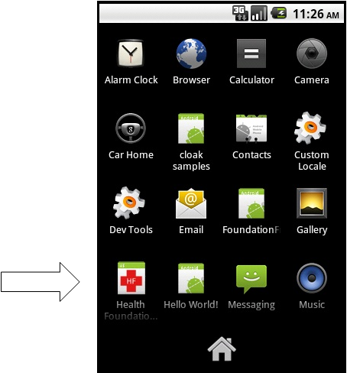
Title A
Subtitle
Author name, email@utdallas.edu; Author2 name, email2@utdallas.edu;
CS 4485 / Fall 2021
Department of Computer Science
Erik Jonsson School of Engineering & Computer Science
The University of Texas at Dallas
Richardson, TX 75080, USA
If sponsored, company logo/name
Abstract
Results
Keywords:(*required)
Architecture
Impact(*required)
Summary
Performance Metrics(*required)

